Slide 1
No Problems Here....
Just Solutions
A Mindfulness Approach ….
to Neurologically Based Psychotherapy

Slide 2
Short Video
(1) Danger Will Robinson, Danger! - Bing video

Slide 3
Introduction
Goals for Presentation:
Reviewing the Basic Assumptions
Identifying the necessary Neurological Mechanisms
Exploring the effectiveness of Solution Based Treatment – More than just finding a solution
Understanding the effectiveness of Mindfulness in facilitating change of solutions in a bottom-up approach

Slide 4
Precursors
Western (What and How)
  -Nature (what is)
  -Nurture (what gets created)
  -The interaction leads to safety, attachments, Goals, Strategies and Narratives

Slide 5
Precursors
Eastern (The nature of Reality)
  Life as Energy
  Presence & Awareness
  Energy as Yin and Yang
  The repetitive and absolute nature of reality.

Slide 6
Assumptions
1st NATURE and NURTURE are constantly active and interactive
2nd This interaction of Nature and Nurture create the CONTENT (what we think/do/say) and PROCESS (how we think/do/say) that we call learning, adapting, development and achieving.
3rd Content can change the Process and the Process can change the Content through ASSIMILATION, ACCOMMODATION, LEARNING, and NEUROPLASTICITY

Slide 7
The Three Brains
Primitive Brain and Vagal Process
  Content (Anxiety, Rage, Sex, Familiarity, biological and concrete)
  Process (enduring, compelling, and without your permission)
Emotional Brain
  Content (Negative, Neutral and Positive Attachments, Emotions, Values
  Process (Beliefs, short term rewards, detached long term outcome, with some level of permission: intensity level determines believability)
Cognitive Brain
  Content (Goals, Knowledge and the stories we tell ourselves)
  Process (Implementation strategies, thinking including errors, cognitive mapping and dissonance management, with intention determining decisions and choice)

Slide 8
example
(Nature←→ Nurture) provides the underlying mechanism/dynamics generating patterns that help us deal with life
  (Nature←→ Nurture) provides the underlying mechanism/dynamics generating patterns that help us deal with life
  Example:
  Better sight
  Visual-motor learning occurs more readily (VML)
  Conditioned, practiced, copied or rewarded by outcomes
  Increased ease and scope of VML use
  Increased value/beliefs/narrative dependency
  Forming a solid repertoire of use

Slide 9
example
(Nature←→ Nurture) provides the underlying mechanism/dynamics generating patterns that help us deal with life
  (Nature←→ Nurture) provides the underlying mechanism/dynamics generating patterns that help us deal with life
  Example:
  Curiosity leads to touching a hot stove
  Pain Receptors being triggered
  Reflex “pulling hand away”
  Conditioned & Rewarded by Relief of pain
  Learning not to touch a hot stove (touching→pain)
  Forming a solid repertoire of use

Slide 10
Nervous System
Significant Other
Senses
Behavior
LIMBIC
Amygdala: Flight Fight Freeze Faint
Hypothalamus: Primary Drives, Growth and Calmness
Hippocampus: Immediate Memory, Emotions, and Values
Vagal
Vagal
Storage
Short-Term Memory
Retrieval
ARAS
Arousal
Vigilance
Sleep
Focus
Attention
Regulation
TPS
Awareness
Sorting
Assigning
Choosing
Responding
Social
Meaning
DRAS
Responding
Coordinating
Integrating
Activity
Cortex
Long term memory
Analysis
Rationality
Logic

Slide 11
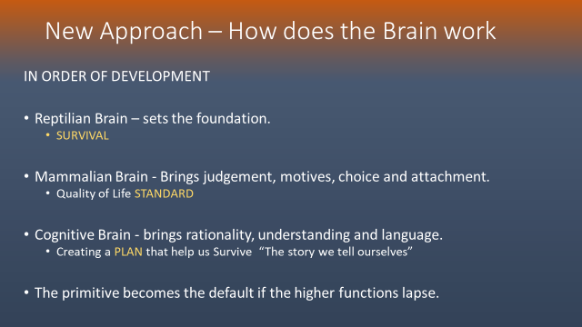

Slide 12
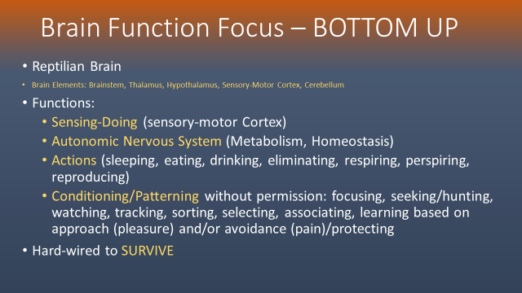
Sensing Danger/Safety to SURVIVE

Slide 13
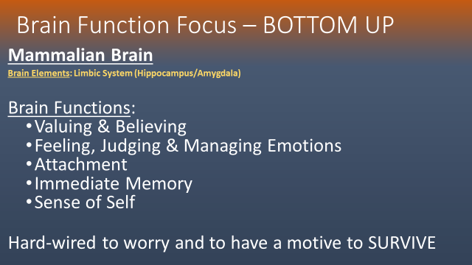
CONNECTING WITH ATTACHMENTS TO SURVIVE

Slide 14
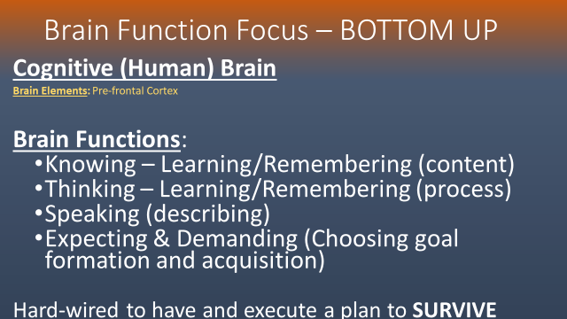
CREATING STORIES GOALS & STRATEGIES TO SURVIVE

Slide 15
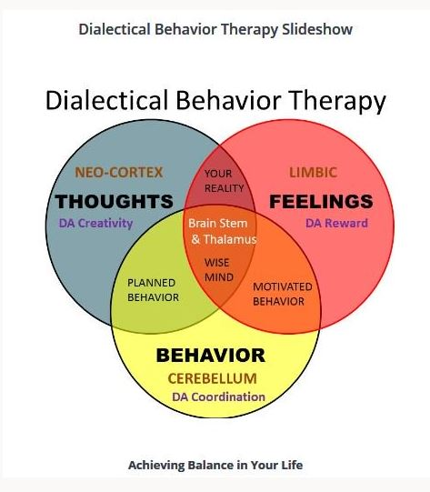

Slide 16
A solution...NOT A PROBLEM
The brain never creates a problem (a neurological impossibility)
Solutions are created by the patient and are situationally specific
Solutions work repeatedly and become established
Repeatedly triggered patterns become habitual
and may generalize to similar prompting events

Slide 17
What is a solution?
Innate and learned Cognitive (& intellectual), Emotional and Kinesthetic Patterns are SOLUTIONS to daily needs, wants and challenges in life.
  Interaction between Nature Nurture creates a need for Solutions
  Solutions relate to Safety, Attachments, Goals, Strategies and Stories (Vision)
  Solution execution involves Active (Yang) and Passive (Yin) energy, Awareness, Presence, Openness (honesty), and Repetition (Will)

Slide 18
How do solutions work 1
Because Solutions are repetitively used, they become:
-unconscious (automatic)
-invisible (without obvious structure)
-feel natural, familiar, compelling even if their effectiveness dwindles over time
and because of these characteristics, Solutions require effort to change.

Slide 19
How do solutions work 2
As a result of prompting events, the brain uses existing solutions or creates new ones, based on the
  Individual's developmental level
  Individual's skill set and prior experience
  External physical and social resources
  The outcome desired
  Target addressed (safety, attachment, understanding)
Solutions accumulate over time and define the perception and response repertoire available to the individual.

Slide 20
How do solutions work 2
Solutions accumulate over time and define the perception and response repertoire available to the individual at any given time.

Slide 21
DIFFERENCE BETWEEN Problems & solutions
Using the MEDICAL MODEL, you correct the existing problem.
The stomach is not working effectively ...Ans: provide medication in to improve stomach function.
  The solution is not changed, it is improved or corrected
Individual is depressed....RX an SSRI and improve the worry cycle of the brain. Depression cured.
  The medical model assumes that improving the neurology alone will reduce depression...and it usually does in many cases.
  What it does not address is:
    Pre-existing patterns that led up to a poorly functioning worry cycle
    Pre-existing patterns that made depression more likely
    Depression now feels normal and familiar, and the person avoids feeling differently
    Patterns of coping with depression cognitively, emotionally and vigilantly.

Slide 22
DIFFERENCE BETWEEN Problems & solutions
IN THE PSYCHOLOGICAL MODEL the Neurology requires you create a solution
Example, Avoiding social events as a solution helped the 6-year-old feel safer in a new school. This allowed him to excel academically for which he was praised; with higher self-esteem in tow around the academic success, the youth concludes that social isolation is a good solution. And he continues to use “avoiding” as a solution. And His peers continue to expect isolation from the 6-year-old.
As he moves through the grades, he continues to use this solution and he does not learn appropriate social skills. By college, this solution is causing him serious difficulty, but he does not know how to change it and he has accepted the story that he has told himself to reduce dissonance. “He is simply a nerd and people don’t like him.”
  Different behavior: 18-year-old with ADHD who is isolated from classmates in high school and totals his car wrapped around a tree, gets arrests for DUI and gets into fights in school with bullies in senior year.

Slide 23
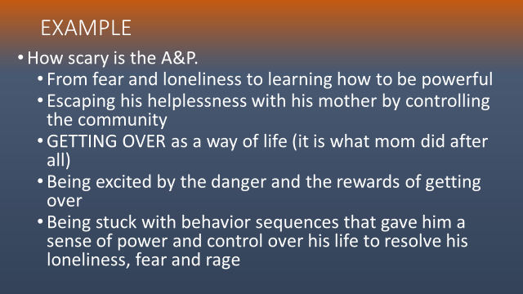
Real example from therapy

Slide 24
A rose by any other name
Solutions are cognitive, emotional and primitive patterns that help the individual to deal with life from moment to moment in a perceived effective manner.
SOLUTIONS ARE PATTERNS
SOLUTIONS ARE PARTS
SOLUTIONS ARE ROLES
SOLUTIONS ARE LOOPS

Slide 25
LOOPS
Loops have a content and process
  The Content of Loops is best described by Lane Pederson's Visual Behavior Change Model. This model is part of his version of Dialectical Behavior Therapy and is used to help patients learn how to change their own ineffective behavior patterns.
  The process of Loops is best described by Beverly Coghlan and Mark Webster in Loops: An Applied Functional Contextual Approach to Health Behavior Change.

Slide 26
Patient Skills required
Benefits of using a Solution based approach
You can ask the person
  To tell you how they resolved an issue with the Solution at hand
  What outcome they were looking for
  For unanticipated results or conclusions
  How well the solution worked and why
  Whether there were times the loop made things worst
  How old they think they were at the point of solution creation
  How they would change the solution so that it works better
  How they would create a new solution in its place
You can praise them for creating and/or accepting the solution for themselves
You can coach them in clarifying, resolving and changing the Solution.

Slide 27
Patient Skills required
Benefits of using a Solution based approach
You started with the content of a Solution...
and end better understanding how it works
Patient starts with not knowing the problem was a solution...
And ends understanding the elements of the solution...
Brainstorming how to change it or create a new one...
And learning the process of problem solving and change.
"Give a man a fish, feed him for a day; teach a man to fish, feed him for a lifetime."

Slide 28
Visual Behavior Change Model
Prompting Event Action Urge Outcomes
Vulnerabilities Surface Emotions Underlying Emotions Self-talk Action

Slide 29
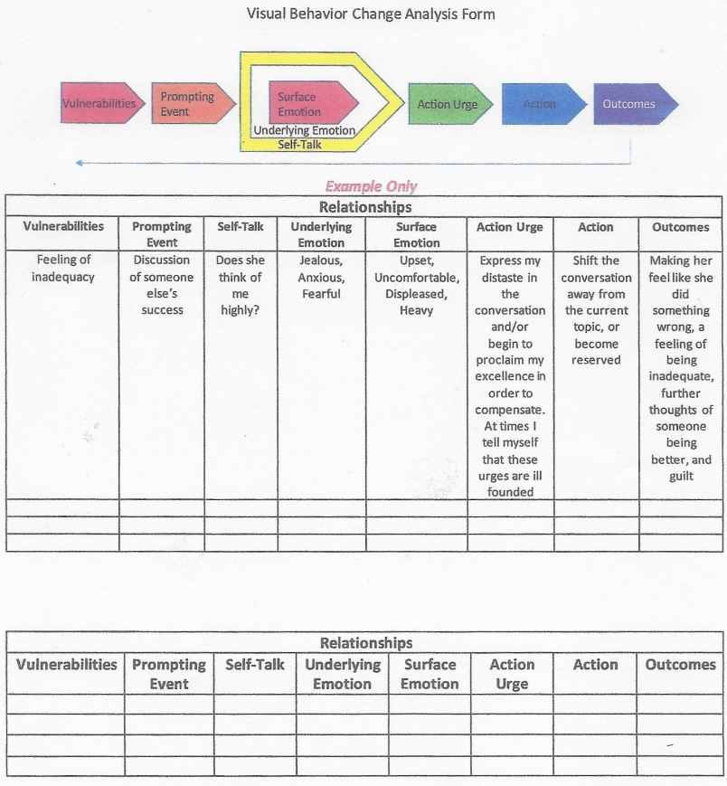

Slide 30
Dynamics of loops
Unwanted feelings, thoughts/physical sensation:
Anxious, shaky, "they'll think I'm boring"
Behavior: I don't to the party
Long-term Vulnerability:
More anxiety, depression, low confidence
Short-term Outcome:
I feel less anxious
EXPERIENTIAL AVOIDANCE
Long-term Vulnerability:
Life of Isolation and poor relationships

Slide 31
Dynamics of loops 2
The Neurological dynamics of LOOPS
  Create a solution that address most easily and directly the event with minimal cost
  Immediate outcome supports the Loop
  Long term outcome is ignored and often is the target of Obsessions and scolding. Scolding re-enforces the notion that the Loop is too difficult to change.

Slide 32
Sample patient loop (trauma Based
Man in the subway!

Slide 33
Focus on the process not the content
Chinese Proverb: “Give a Man a Fish, feed him for a day: Teach a man to fish, feed him for a lifetime”.
Mindful Strategy focuses on what is real and what works.
Mindful Strategy focuses on accepting reality both psychological and phenomenological
Mindful Strategy focuses on honesty and being opened to the possibility that you are wrong.
Mindful Strategy focuses on what process we can change that will make us more effective.
Focus in on being effective in our life, based on what we want as long as what we want is honest (in line with reality). →This is a pragmatic view of life

Slide 34
Process of loops
LOOPS address immediate survival needs, emotional attachment needs and/or dissonance reducing needs.
LOOPS have long-term consequence which reinforces the vulnerabilities.

Slide 35
Nature of energy
Energy is what initiates and sustains thinking, saying and doing.
Energy can be about action or inaction.
How we practice the use of energy becomes a loop which defines our disposition and destiny

Slide 36
Nature of energy
The concept of Energy is best operationalized by Yin and Yang.
Yang is the strong energy that leads to action. It is the DOING FORCE;
Yin is the soft energy that permits us to allow. It is the ACCEPTING FORCE.
In Western culture, Yin Yang is best illustrated by the Serenity Prayer:
God grant me the serenity
-To accept the things I cannot change,
-The courage to change the things I can,
-And the Wisdom to know the difference.
-Living one day at a time,
-Enjoying one moment at a time.

Slide 37
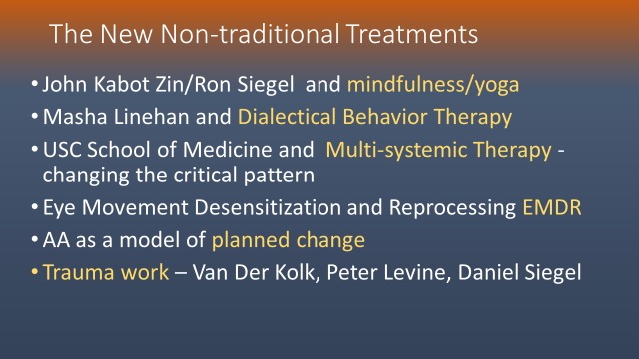
Polyvagal Theory – Stephen W. Porges
Treatment of Trauma, Janina Fisher

Slide 38
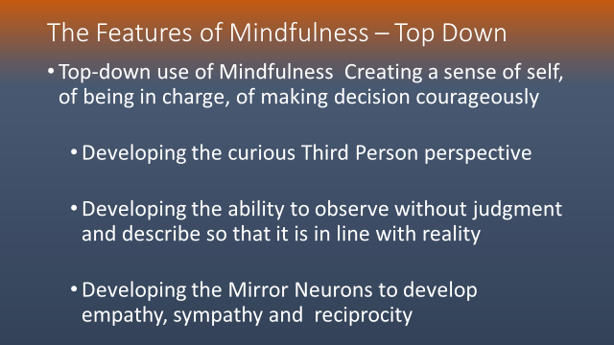

Slide 39
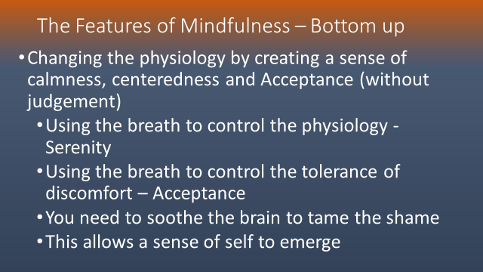

Slide 40
