Slide 1
Mindfulness!
A Critical Process to A Happy Life

Slide 2
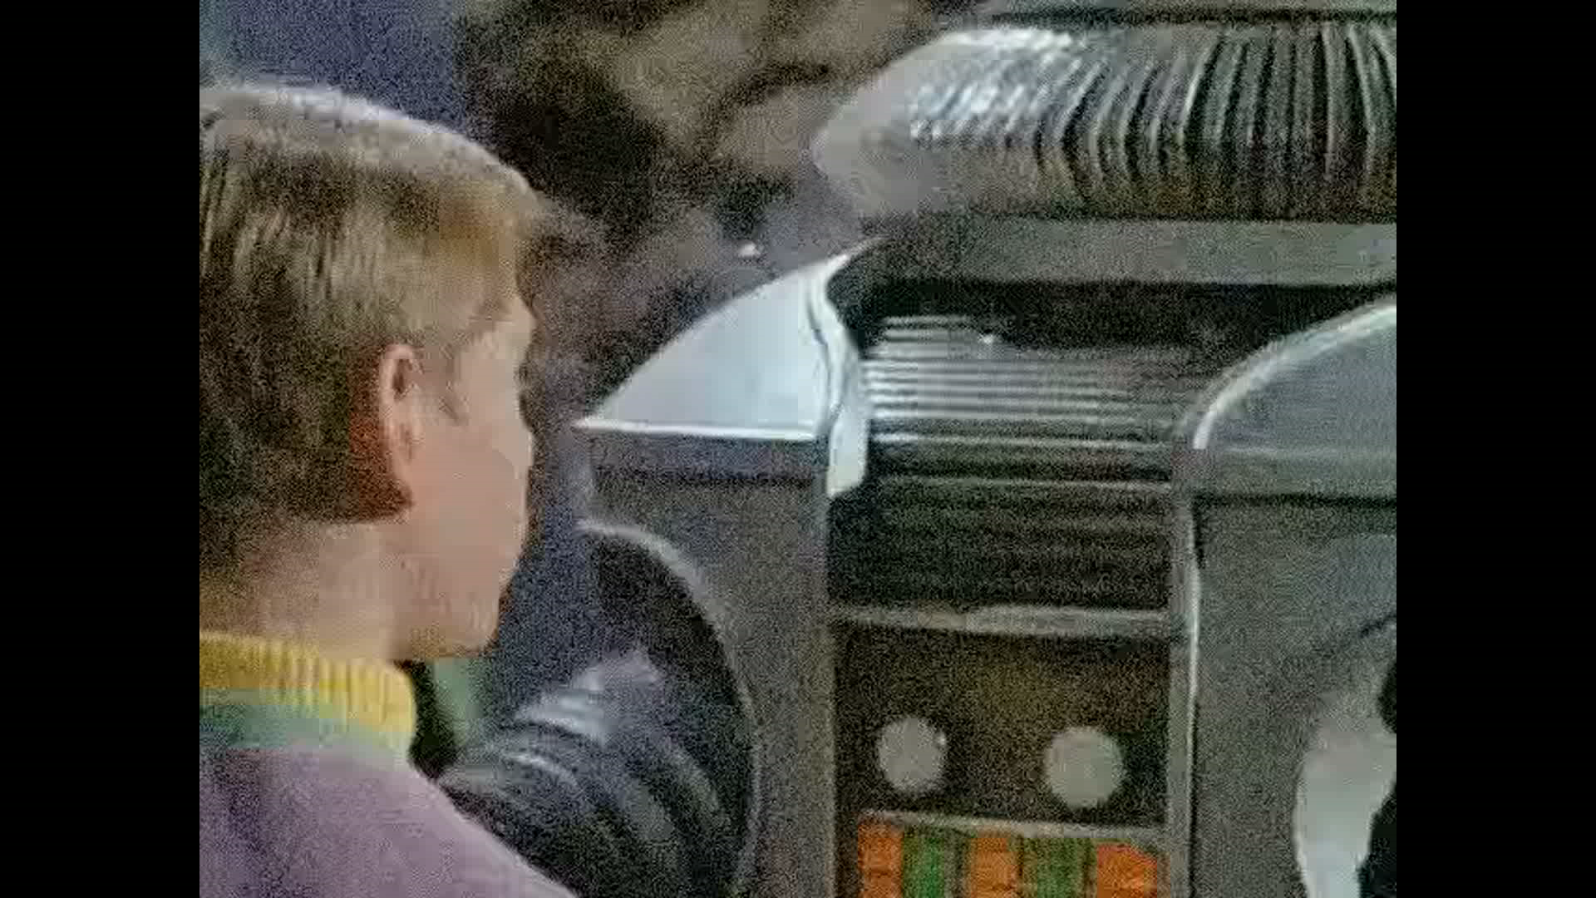
Mindfulness – A Critical Process
Is to create Happiness the goal of Mindfulness?

Slide 3
Mindfulness!
A Critical Process
Goal 1 Know what it is
Goal 2 Experience what it is
Goal 3 Know where to apply it
Goal 4 Know why it is critical

Slide 4
Mindfulness
Exercise 1 Observe (eyes opened)

Slide 5
Mindfulness
Exercise 1 Debrief
What did you see?
What did you tell yourself about what you saw?
How did your Awareness about the room change?

Slide 6
Mindfulness
Exercise 2 Observe (eyes opened new/old)

Slide 7
Mindfulness
Exercise 2 Debrief
What did you see differently?
How did your Awareness grow?
Are you telling the truth?
Are you giving telling facts or opinion?

Slide 8
Mindfulness
Exercise 3 Watch Focus (eyes closed TFS /E)

Slide 9
Mindfulness
Exercise 3 Debrief
What did you observe?
How did your Awareness grow?
Are you judging what you observed
Are you willing to share or do you change the story?

Slide 10
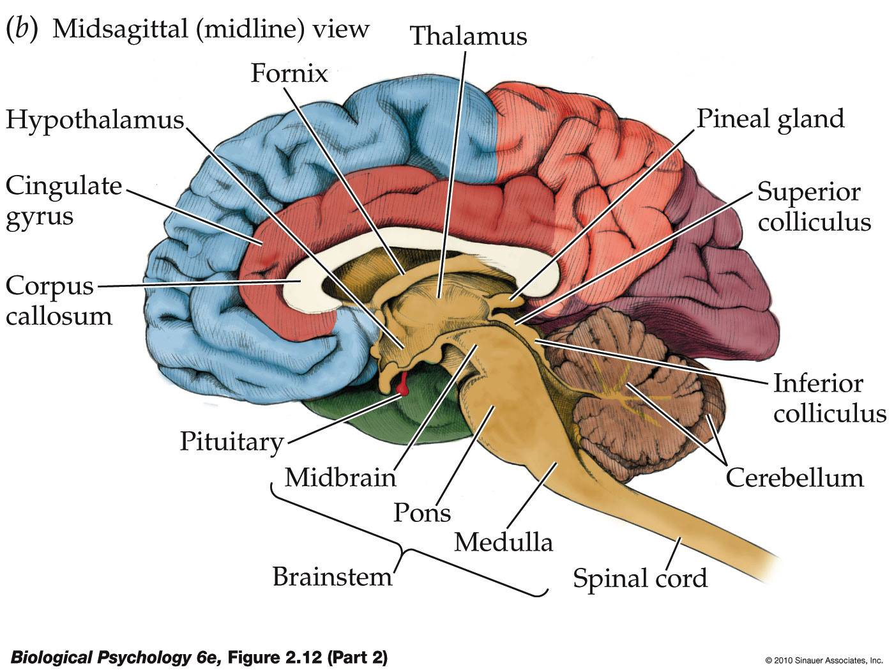
Neurological explanation of Mindfulness
The 3 Brains:
1 Frontal Cortex (Thinking)
2 Limbic (Feeling)
3 Brain Stem, Parietal Cortex & Cerebellum
(Behavior)

Slide 11
Nervous System
Significant Other
Senses
Behavior
LIMBIC
Amygdala: Flight, Fight and Freeze
Hypothalamus: Primary Drives, Growth and Calmness
Hippocampus: Immediate Memory, Emotions, and Values
Cerebellum
Muscular Coordination
TPS
Awareness
Sorting
Assigning
Choosing
Responding
Storage
Short-Term Memory
Retrieval
ARAS
Arousal
Vigilance
Sleep
Focus
Attention
Regulation
Social
Meaning
DRAS
Responding
Coordinating
Integrating
Activity
Cortex - Prefrontal
Long term memory
Analysis
Rationality
Logic
Cortex – Parietal
Muscular Repertoire

Slide 12
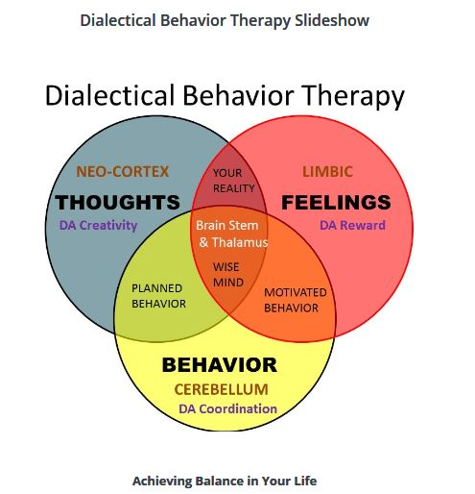
DBT Based

Slide 13
Mindfulness: A Critical Process
How do we develop and maintain Happiness?
Is it Content or Process that’s important:
Process:
  Self Reflection allows us to assess on our thoughts, feelings, behavior, and outcomes.
  Self Reflection is based on our beliefs and values regarding what works
  Self Reflection stores in Memory the pattern that works because the outcome provides a reward.
  SO WHAT IS THE PROCESS OF SELF-REFLECTION

Slide 14
Mindfulness: A Critical Process
Mitigating Factors
History of established patterns/skill set
Developmental Level
Impactful experiences such as trauma
Functional level of the Brain Stem
Interaction among the three brains
Functional level of the brain (stem) is changed physically by history/development/trauma.

Slide 15
Mindfulness: A Critical Process
What is the functional process of Mindfulness
1. Cognition (Knowing)
2. Emotion (Attaching)
3. Sensing & Behavior (Observing/Responding)
4. Presence (knowing who, where and what we are)
5. Self Reflection (Observe w/out judging)
6. Self Regulation (Staying on target)
7. Self Correction (Changing to get there)

Slide 16
Mindfulness
Exercise 5
Observe/focus on your breath
Attend/intend to your breath
Track the breath (Vigilance)
Notice the breath in/out (Doing/Allowing)

Slide 17
Mindfulness OPTIONAL
Exercise 6 Vigilance (Track the observing, watching, tracking, responding and judging) -breath/bell

Slide 18
Mindfulness: A Critical Process
What about your awareness?
Specialized – thoughts-visuals-auditory-feelings-sensations
Focus – singular- multiple – drifting - cohesive
Attention – doing-allowing-pulls/push-avoidance
Vigilance – Seeking- sustaining- clarifying – directing
Responding – Behaving- evaluating- correcting- Staying on target

Slide 19
Nervous System
Feedback loop: Behavior →Significant Other → Senses + Behavior → Senses
Significant Other
Senses
Behavior
LIMBIC
Amygdala: Flight, Fight and Freeze
Hypothalamus: Primary Drives, Growth and Calmness
Hippocampus: Immediate Memory, Emotions, and Values
Cerebellum
Muscular Coordination
TPS
Awareness
Sorting
Assigning
Choosing
Responding
Storage
Short-Term Memory
Retrieval
ARAS
Arousal
Vigilance
Sleep
Focus
Attention
Regulation
Social
Meaning
DRAS
Responding
Coordinating
Integrating
Activity
Cortex - Prefrontal
Long term memory
Analysis
Rationality
Logic
Cortex – Parietal
Muscular Repertoire

Slide 20
Mindfulness
Exercise 11 Vigilance (Track the tracking and responding – Self Correcting) -Taichi – how is it working

Slide 21
Mindfulness
Exercise 12 Persistence (Challenge Meditation. -tracking I-E, responding and Self Correcting) -Taichi – how is it working

Slide 22
Mindfulness: A Critical Process
Meeting our needs or goals ultimately depends on our expectations and ability to observe and work with reality
Self reflection is critical to keeping us in touch with reality, our personal reality and our outcomes so that we can set our path and self correction as necessary

Slide 23
Mindfulness: A Critical Process
3. BUT Self Reflection also gives us the ability to create future goals or expectations
4. This gives us the ability to choose alternatives and the ability to override even our basic needs
5. Expecting goals that are unreasonable, unattainable or self destructive lead us to at best acquire temporary happiness.
6. All changes, good and bad, change the brain

Slide 24
Mindfulness: A Critical Process
Functional Priority
First Layer ATTITUDE
Cortex → Likes/Dislikes→ Choice/Intent →Survival
Second Layer EMOTION
Limbic → Attachment → Yearning → Survival
Third Layer SENSATION
Brainstem →(Pleasure/Pain) → Survival
These are equivalent but not the same→ If higher order fails the default is the next layer

Slide 25
Mindfulness: A Critical Process
Training the brain to give the brainstem priority
  Allows for more direct observation
  Reduce judgement by reducing attachment (Limbic) to thinking, feelings, and behavior
  Learning to accept reality
  Learning how to observe (awareness) what we want, need, think, say, do, and how we self regulate in the presence of external reality.

Slide 26
Mindfulness
Exercise 13 Watch (Awareness of third person has grown improving observing, tracking, responding and self correcting) - how is it working?

Slide 27
First Stop

Slide 28
Mindfulness: A Critical Process
Thinking Patterns (Our Story)
Watch your thoughts…they become words
Watch your words…they become actions
Watch your actions…they become patterns
Watch your patterns…they become habits
Watch your habits…the become character
Watch your character... It becomes your destiny
Lao Tzu

Slide 29
Mindfulness
Exercise 3 Watching Our Story

Slide 30
Mindfulness: A Critical Process
Patterns of Emotions
Emotions are difficulty to identify
People experience more than one at the same time, e.g. fear/anger, love/hate
Some Emotions are basic, some complex and some complicated, e.g. scared, helpless, insignificant

Slide 31
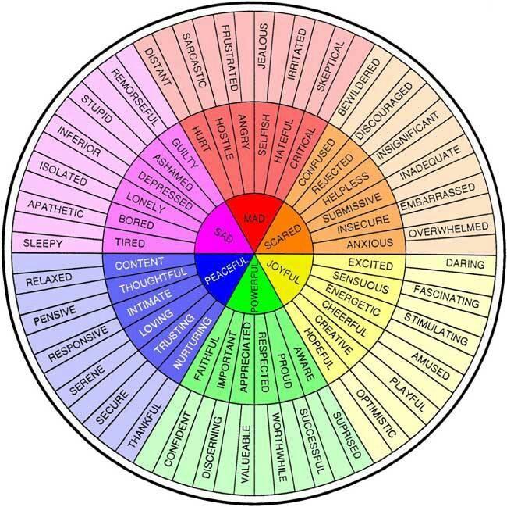
Levels of Emotions

Slide 32
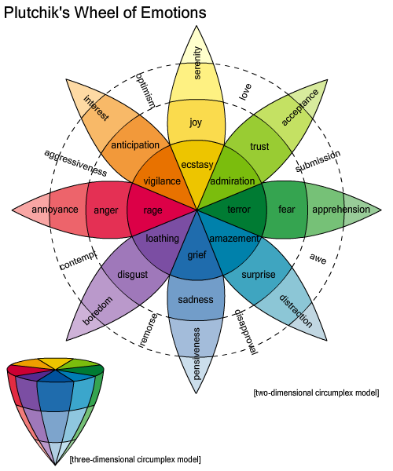
Emotion

Slide 33
Mindfulness: A Critical Process
Intensity of emotions:
Make us feel right/wrong
Make us feel in control/overwhelmed
Make us feel powerful/helpless
Make us feel determined/hopeless
Emotions attach to our story and support it

Slide 34
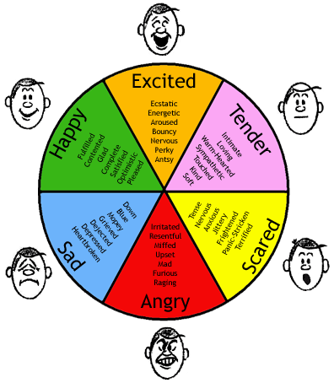
INTENSITY

Slide 35
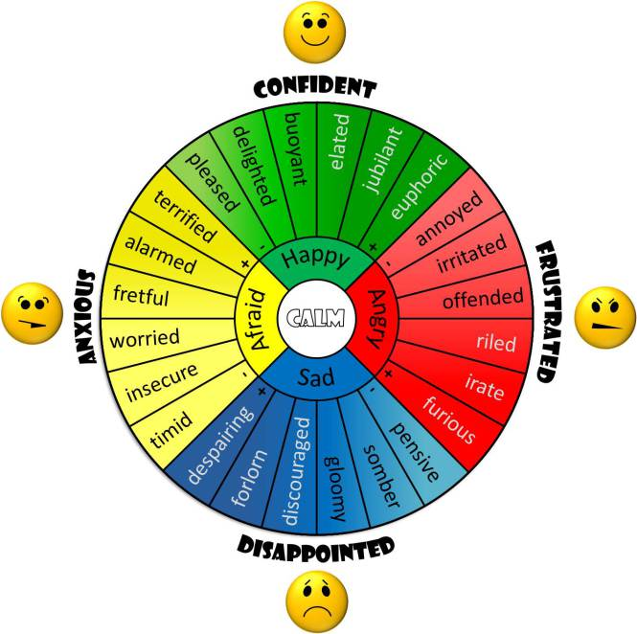
REACTIvity

Slide 36
Mindfulness: A Critical Process
Patterns of Behavior
What you practice is what you do
What you practice establishes your skill set
What you practice defines your potential
What you practice leads to specific outcomes

Slide 37
Mindfulness: A Critical Process
Happiness requires effective self reflection of thoughts, feelings, behavior and outcomes.
Happiness requires that we keep in touch with reality and clarify what works in our life leading to effectiveness, efficacy and self-correction.
These processes requires self-reflection, Co-regulation and self-regulation

Slide 38
Mindfulness: A Critical Process
Skill Building
Presence

Slide 39
Second Stop

Slide 40
What is Mindfulness – loose Definition
Mindfulness is simply watching what is and what happens without judgment so that you have clarity of choice and action

Slide 41
What is Mindfulness – Brief Intro
Paying Attention
One Minute Observation
  Observe
  Describe
  Increased Awareness

Slide 42
Where does it apply
Increased Attention (Focus-Vigilance-Tracking)
Increased Reality Testing (Being Objective)
Increased Self Reflection (The Third Person View)
Improved Thought Management (Racing Thoughts)
Improved Emotional Regulation (Impulses)
Improved Behavioral Control (Urges)
Improve Relationships (Getting Along)

Slide 43
Historical and Scientific Basis
Dialective Behavior Therapy – Marsha Linehan & Lane Pederson
Somatic-base Psychotherapy – Peter Levine & Dan Siegel
Working with Anxiety – Jon Kabat-Zin
Polyvagal Theory – Stephen Porges
Trauma – Bessel Van Der Kolk

Slide 44
MINDFULNESS - DEFINED by Jon Kabat-Zin
The awareness that emerges through paying attention on purpose, in the present moment, and non-judgmentally to the unfolding of experience moment to moment

Slide 45
Brain Stem & Limbic
Arousal (ARAS)
Levels of consciousness (awareness)
Focus (Selecting)
Attention (intention/watching)
Vigilance (tracking)
Regulation (evaluating/correcting)
How important are these processes to your life/work?

Slide 46
Exercise 1 (The watering hole)
Observation of physical experience
Possible Groups
  People who stayed focused on pre-noise
  People who had turned by responded in the moment
  People who did not turn toward the noise right away
Brain stem development at the watering hole

Slide 47
Awareness that Emerges
Waking up to our experience
Not being stuck in the past or future (source of worry, anxiety and fear)
Not Avoiding the present (source of reward for worry, anxiety and fear)
Embracing the present (source of our courage)
Reflection on examples from your life today!
Notes:
Exercise: close eyes body scan, id stress points, breath thoughts feelings

Slide 48
Through Paying Attention
Arousal (and level of consciousness)
Vigilance (keeping the mind attending, and not wandering)
Selective Attention (focusing on one thing and keeping out distractions, not by forcing but by allowing)
Types of attention: focus, sustained, selective, alternating and divided
Reflection on examples from your life today!

Slide 49
On Purpose
Stepping out of automatic pilot and deliberately and consciously paying attention
Deciding WHAT we pay attention to
Developing HOW we pay attention
  Habitual attitude of non-judgmental acceptance
  Breaking out of maladaptive restrictive patterns
  Accepting, attending, liking ourselves, embracing humanity and the universal truth
Not Coast by taking DECISIVE ACTION
Reflection on examples from your life today!
Notes:
Exercise: With your eyes closed, choose some thing that annoyed you in the last 24 to 48 hours. Remember the details. Taking a different perspective of accepting your part in this event as objectively as you can.

Slide 50
In the Present Moment
Eliminating ruminations about the past and worries about the future
Learning that feelings are not you
Get grounded in reality by observing the present
Notes:
Exercise: with your eyes closed, focus on your thoughts about the event you described in the prior exercise. Allow yourself to think about the thoughts and feelings while keeping a distance. Let them come and go at will. See that your are not your thoughts but that your thoughts are experiences you have.

Slide 51
And Non-Judgmentally
Our minds constantly make comparisons
We need to observe these without getting overly involved
Letting go of judgment leads to acceptance of reality, liking yourself, and freedom to be yourself
Willingness to accept leads to openness to reality
Paradox: changing requires accepting what is
Notes:
Exercise, with your eyes closed repeat the word “no” softly at first, louder, and then with more determination. Notice how your physical, thoughts, and/or feelings change. Repeat with the word “Yes”.. Then ask participants with eyes opened to tell the difference between their physical, thoughts and feeling experiences

Slide 52
Third Stop

Slide 53
To the Unfolding Experience Moment to Moment
Not static and passive
Participants in Mindfulness must participate
Participants in Mindfulness must choose
Participants in Mindfulness must decide
Participants in Mindfulness must act

Slide 54
Where does it apply
Increased Attention (Focus-Vigilance-Tracking)
Increased Reality Testing (Being Objective)
Increased Self Reflection (The Third Person View)
Improved Thought Management (Racing Thoughts)
Improved Emotional Regulation (Impulses)
Improved Behavioral Control (Urges)
Improved Relationships (Getting Along)

Slide 55
Mindfulness: A Critical Process
Application
Socratic Teaching Self questioning about how it’s working for them – keeping them present
Validate who they are and where they are – being in the present
Focus on Honesty (dishonesty is self sabotage)
Challenge being a Victim of Themselves
Identify the Behavior Pattern to change
Highlight the Impact of the Outcomes

Slide 56
Mindfulness: A Critical Process
Wise mind: Reality base – Being present
Wise mind: Observation base – Being Present
Wise mind: Outcome base – Being Present
Wise mind: Behavioral Analysis – knowing self
Wise mind: Pros and Cons – Anticipating
Wise mind: Willingness vs willfulness
Wise mind: Non-judgmentally – no attachment
Wise mind: Self-Reflection – Self correcting
Wise mind: Goal Directed – what you want/need

Slide 57
Mindfulness: A Critical Process
Resources
1. Stephen Porges, Polyvagal Theory
2. Bessel Van Der Kolk, Body Keeps the Score
3. Peter Levine, Awarkening the Tiger
4. Kabat-Zin, Mindfulness
5. Ron Seigal, The Scientific Basis of Mindfulness
6. Marsha Linehan, Dialectical Behavior Therapy
7. Lane Pederson, Dialectical Behavior Therapy

Slide 58
Mindfulness: A Critical Process
For more information on Mindfulness in Psychotherapy or to get an electronic copy of the slide presentation
Visit our Website: http://bwcassociates.com

