Slide 1
Trauma, Truancy and Strategies
Changing the Unchangeable

Slide 2
Goals for Training
Establish a common framework by:
  Re-affirming and Clarifying the definition of Truancy
  Redefining the nature of the playing field
Consider Truancy as a “stealth” phenomenon:
  Level 1 Proximal Pattern – (w/ or w/out one-trial learning)
  Level 2 Distal Pattern – (w/ or w/out one-trial learning)
  Level 3 Trauma Based
Explore how trauma clarifies the Truancy Recidivism

Slide 3
Something Old
Something New
Something Borrowed
Something True
In order to have a common Framework we start with something old

Slide 4
OLD
Exploring the dilemma of defining delinquency.

Slide 5
DEFINING TRUANCY/SCHOOL REFUSAL
Truancy… as a legal issue having reached the required number of days
Truancy…as a status offense.
Truancy…as a student being absent (excused or not)
Truancy…as a student of school age has unexcused absences
Truancy…as a student who attends late, misses classes, leaves early
Truancy…as a student who is here but not present
Is it Truancy or School Refusal????

Slide 6
DEFINING TRUANCY – Complication factors
But WHO is “the truant”?
  The youth who is absent or not present
  The negligent and discouraging parents
  The abusive sibling
  The sick or hungry family member
  The divorcing or arguing parents
  The encouraging friends
  The unsafe streets
  The inattentive or careless school
  The impossible education program
  The remiss teacher
  The student who is a bully……….
Fixing the problem requires knowing the etiology

Slide 7
Truant – Vinny 1998
14 year old in the 8th grade
Bi-racial youth
Mother is deceased from a catastrophic illness
Living with the maternal grandparents in a predominantly Jewish/Italian neighborhood
Absent from School a number of days – some of which are excused
Absent from classes repeatedly
Missing during lunch time
Transfer from another school – is Classified with ADD
Poor academics – homework late and poor grades on tests and projects
Class clown but not necessarily difficult to manage in the classroom

Slide 8
Your Assessment!
Why is he truant?

Slide 9
Getting it right depends on four factors
The definition you believe in
Distal vs Proximal Patterns for youth, parents, school
How engrained the pattern is
The Level of Urgency
Who to involve and when
For many, truancy is a life long pattern

Slide 10
A TRUANCY IS A LIFE LONG PROBLEM
  Academic difficulties → School Failure
  (Because quitting is easier than catching up)
  Chronic absenteeism predicts delinquent behavior
  Higher risk for drug/alcohol abuse, pregnancies, and violence
The Office of Juvenile Justice and Delinquency Prevention
(Federal Government)

Slide 11
A TRUANCY IS A LIFE LONG PROBLEM
Truancy →
      Lack of necessary education/training
      Unemployment
      Poor salaries
      Adult Criminal Behavior
      Social Isolation from peers
      Social Isolation from the larger community)
      Substance Abuse
      Low self esteem and anxiety
      Mental Health and Family Health Issues
The Office of Juvenile Justice and Delinquency Prevention
(Federal Government)

Slide 12
Truant – Vinny Revisited 2013
28 year old unemployed
Articulate, bright, well-dressed.
Living with his older married sister for the last two months
Started but did not finish college
Recently left his girlfriend and child in Florida
Sporadically employed in management positions over the years
Incarcerated several times for minor and major thefts
Has spent 6 of the last 15 years in jail in several states
6 months after meeting with him he is jailed for a new offense

Slide 13
TREATING TRUANCY IS A CLINICAL PROCESS NOT A LEGAL ONE, REGARDLESS OF WHY A YOUTH IS ABSENT!

Slide 14
NEW
Exploring a coordinated model of truancy intervention – a Macro Event

Slide 15
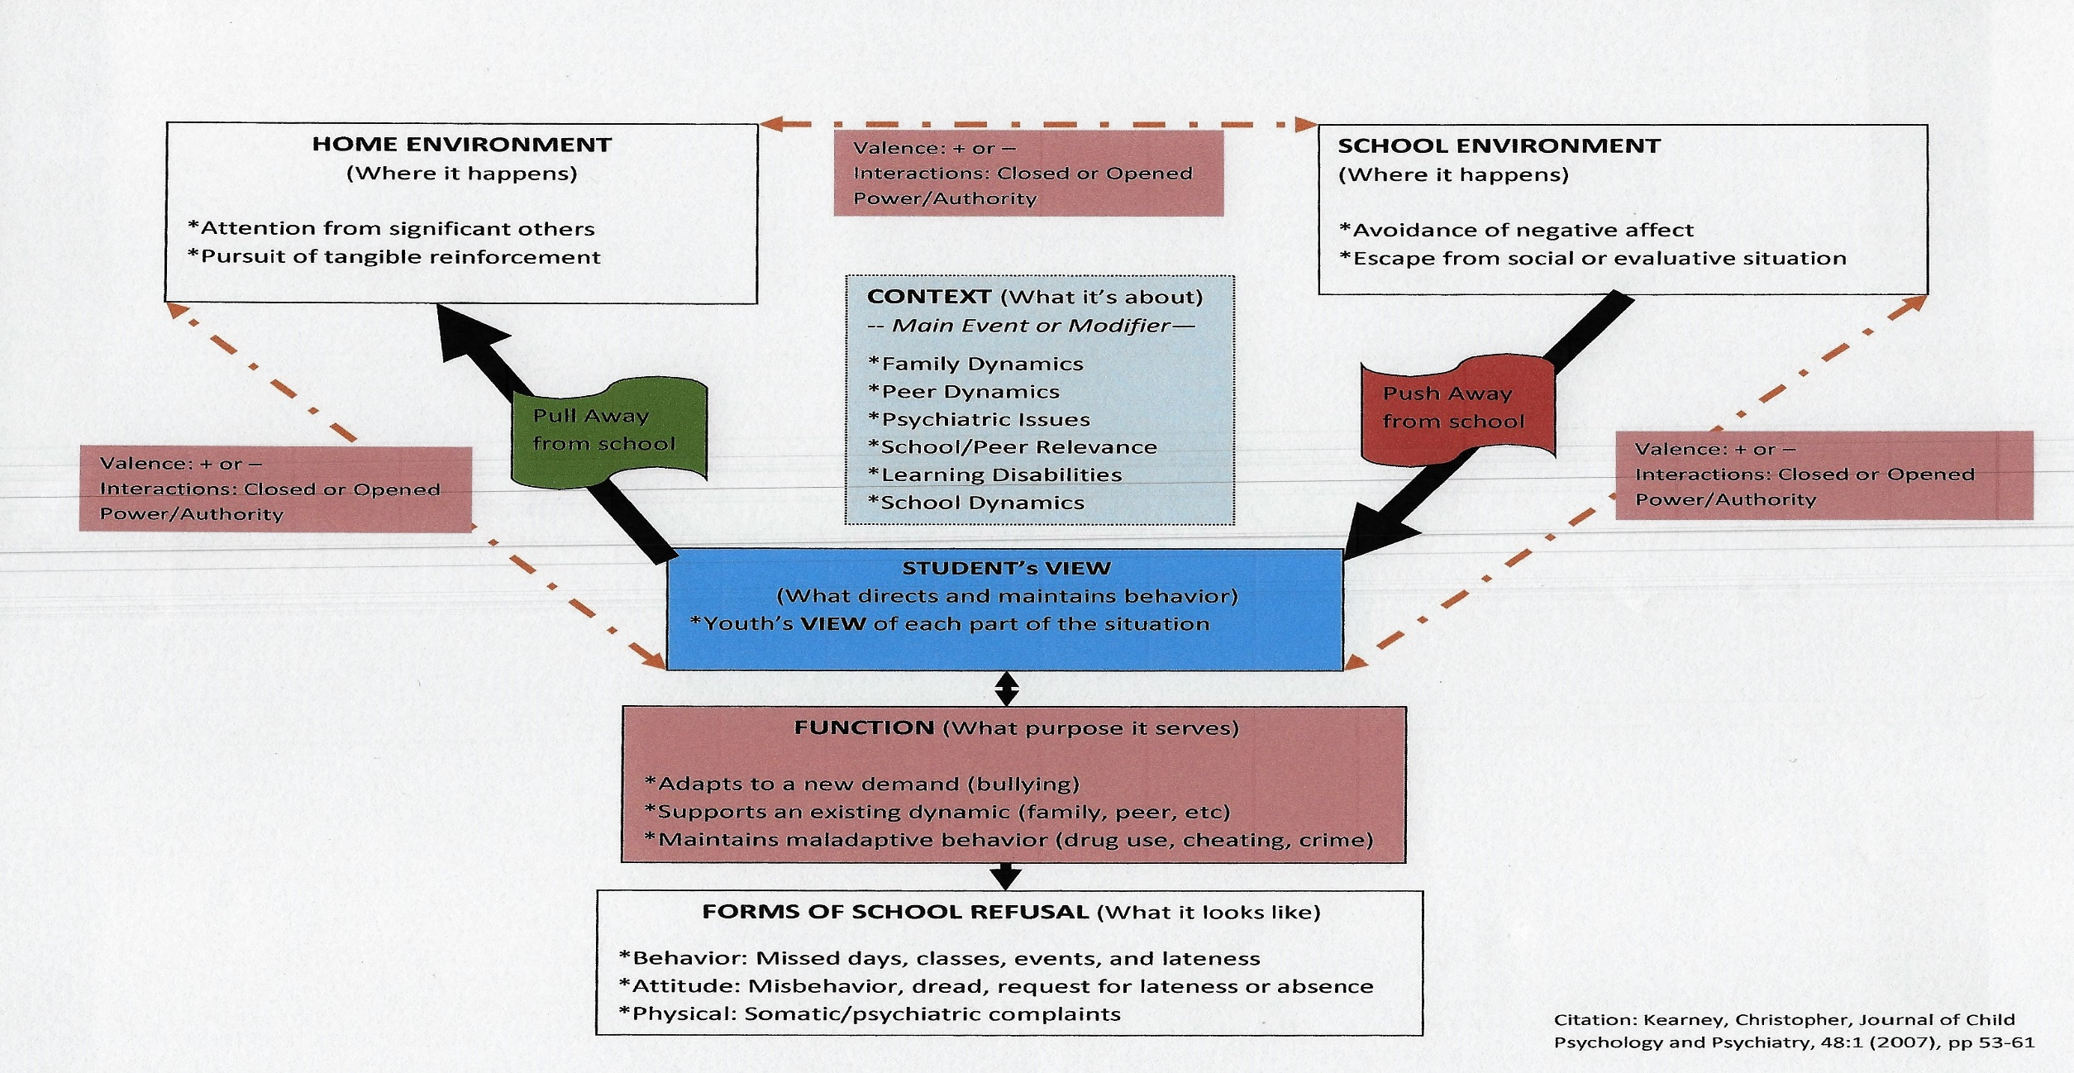
Truancy Intervention Model - MACRO LEVEL
Adapted 2014 From Christopher Kearney

Slide 16
This model begins to explain how you can differentiate between definitions of truancy
…….And therefore which set of macro responses may be more effective

Slide 17
What are the Macro solution?
Use the Macro Solutions Wisely:
  The School
  The Family/Parents
  Neighborhood/Extended Family Resources
  Mental health providers
  Established Resources to care for the family
  The Crisis Response Team and/or JFCIU
  The CMO
  DCP&P & IA
  Law enforcement
  The courts

Slide 19
School Refusal – Forms of School Refusal
“What does it look like?”
Behavior:
  Missed days, classes, events, lateness and earliness
Attitude:
  Misbehavior, dread, request for lateness or absence
Physical:
  Somatic/psychiatric complaints and illness

Slide 20
School Refusal – WHAT IS IT’S FUNCTION?
“What purpose does it serve and for whom?”
  Adapt to a new demand such a bullying, academic challenges, parental needs
  Supports an existing dynamic in the family or among peers/adults
  Maintains maladaptive behavior such as drug use, cheating, crime, disobedience at home

Slide 21
Things that contribute to Truancy
School Factors (Push Away):
  Avoidance of Negative Affect (fear, shame, sadness, awkwardness, loneliness)
  Escape from Social Situation such as conflict or inappropriate behavior among staff/students, e.g. Bullying
  Escape from Evaluative Situations (Inappropriate programming/challenges)
  Lack of policy and procedures
  Physical condition of the school
  Lack of attention to special educational needs
  Lack of appropriately trained staff

Slide 22
Things that contribute to Truancy
Home/Community Factors (Pull Away):
  Family Health or Financial Concerns (student needs to take care of family)
  Youth is a victim of or witnesses abuse or neglect
  Pressures arising from pregnancy/child care (self or others in the family)
  Safety concerns at home or between the home and school
  Parental drug abuse or alcoholism
  Poor peer/sibling/parental role modeling
  Parents do not value education
  Language barrier
  Lack of food or transportation
  Homelessness
  Lack of parental involvement

Slide 23
PULL AND PUSH – TOWARD TRUANCY
    Not unlike any other behavior
    But yet in truancy, more room to misunderstand because each player defines truancy differently
    You can have more than one push and one pull and a combination thereof

Slide 24
Managing the push/pull of the players

Slide 26
PULL AND PUSH OF THE PLAYERS 1
  Valences + or -
  Valences as values, beliefs, expectations, status and power
  Valences embedded in peoples’ emotions and judgments
  Valences apply to triads
  Examples of triads:
    School <-> Youth <-> Parent <->School
    School <-> Father <-> Mother <-> School
    School <-> DCP&P <-> Parents <-> School
    School <-> Counselor <-> Youth <-> School
    School <-> Parents <-> Police <-> School

Slide 27
TRIAD OF INTEREST
YOUTH
SCHOOL
PARENTS

Slide 28
PULL AND PUSH OF THE PLAYERS
Configuration of Valences in the Triad
School <+> Youth <+> Parents <+> School Closed All Agree Focused Change
School <+> Youth <-> Parents <+> School Opened Adults agree Parent/child Conflict
School <-> Youth <+> Parents <+> School Opened Adults agree School/child Conflict
School <+> Youth <+> Parents <-> School Opened Adults disagree School/Parent Conflict
School <-> Youth <-> Parents <+> School Closed Adult agree Youth Alienated
School <+> Youth <-> Parents <-> School Closed Adults Disagree Parent Alienated
School <-> Youth <+> Parents <-> School Closed Parent/Child Agree School Alienated
School <-> Youth <-> Parents <-> School Opened All Disagree All in Conflict

Slide 29
DEFINING TRUANCY – Macro solution
Use the Macro Solutions Wisely:
  Family Members
  Neighborhood Resources for support
  Mental health providers
  Resources to care for the family
  The crisis unit
  The CMO
  DCP&P
  Law enforcement
  The courts

Slide 30
MACRO APPROACHES TO TREAT TRUANCY
Using the seriousness of the Truancy as a measure
  Is it also illegal
  Is it also dangerous physically or medically
Using the Recidivism/Repetitiveness as a measure
  Has it reached the level of the law to define it as truancy
  Has it reached the level of academic failure
Using the Push/Pull of the players as a measure
  Who agrees and who is alienated
  Who has the power

Slide 31
Vinny Revisited – Prep Slide
What is the function of the truancy?
Who would you involve in this case and why?

Slide 32
Truant – Vinny Revisited 1994
“If looks could kill!”
10 year old youth 4th grader
Bi-racial child from the romantic involvement of an Italian mom and a African American dad.
Vinny visits dad every other week
Vinny is enrolled in a local public school within walking distance from home. He has an older sister by two years
Vinny and his sister are latch-key children
Mother is employed as a receptionist and they live in a one bedroom apartment
They live from pay check to pay check

Slide 33
Truant – Vinny Revisited 1994
If looks could kill!
In appearance, Mom seems to be doing the best she can
Vinny is acting up in school, being the school clown
Vinny is a classified student
Vinny sometimes disappears from home but he is thought to be riding his bike
Mom has a hard time with both children getting homework done
Mom is fed up with the school and gets into a fight with the CS Team
Mom, at the urging of her brother, gets help for Vinny
Mom enters my office! (If looks could kill)

Slide 34
Truant – Vinny Revisited 1994
One year of treatment
Child study team review
Illness and death of the mother (abandoned mentally and physically)
Change of school to the maternal grandparents district 1998
Vinny is truant
Vinny skips classes and lunch times
Vinny smokes blunts on school property
Vinny’s grandmother is called in
Vinny’s grandfather is called in (what definition was the school using)
Vinny moves on to high school and graduates?

Slide 35
Vinny Revisited
What is the function of the truancy?
Who would you involve in this case and why?

Slide 36
So Truancy is more than a Macro event

Slide 37
Truancy – Trauma Robert Melillo
Disconnected Kids
Different Symptoms, One problem
Truancy looks alike generally but the etiology can be varied

Slide 38
SCHOOL REFUSAL – The Context
What is the issue or what is it about
  Family Dynamics
  Peer Dynamics
  Psychiatric Issues
  School/Peer Relevance
  Learning Disabilities
  School Dynamics

Slide 39
SCHOOL REFUSAL – Student’s View
The student’s view is what directs and maintains the behavior
The student’s patterns is what keeps him/her stuck
Trauma makes matters worse

Slide 40
BORROWED
Exploring the relevance of Trauma work to Truancy - The Micro Event

Slide 41
SOMETHING BORROWED
Lao Tzu
Watch your thoughts
Watch your words
Watch your actions
Watch your patterns
Watch your Habits
Watch your Character……………. It becomes your destiny

Slide 42
Guiding Principle 1: View, Character and Destiny
Individual thinks of self, others and their relationship
Thinking leads to saying
Thinking and saying leads to behaving toward self and others
Repeating the thinking, saying and actions forms patterns
Repeating patterns leads to habits
Habits that lead to feelings of effectiveness are repeated, become unconscious and make up your character
Our character leads us to where we are headed, our destiny

Slide 43
Guiding Principle 1: The stories we tell ourselves

Slide 44
Guiding Principle 2: The nature of Habits
Habits learned over time and through instrumental conditioning are more amenable to change
Habits learned in a short amount of time through classical conditioning are more resistant to change
  Classical Conditioning is primitive and applies to all animals
  One trial classical conditioning is usually about a critical event and is more permanent
  Classical conditioning that comes from unexpected outcomes or surprise is more permanent
  Classical conditioning that involves trauma increases the resitance to change
  The person is STUCK

Slide 45
Vinny - Revisited 1991
How scary is the A&P?
  From fear and loneliness to learning how to be powerful
  Escaping his helplessness with his mother by controlling the community
  GETTING OVER as a way of life (it is what mom did after all)
  Being excited by the danger/rewards of getting over
  Being stuck with behavior sequences that gave him
    a sense of power and control over his life
    resolve his loneliness, fear, rage and mom’s meager salary and limited love

Slide 46
Truant – Vinny Revisited 1991
As a child his imagined destiny was limited to what children think…but it was not the one he thought
As players, the “Stealth Path” he was traveling was not revealed to us… leading to a disaster…and we all participate eagerly thinking we had the solution
What Vinny learns:
  Mom’s expectations/demands lead to rewards (attention/power) from others
  Getting something for nothing
  Being independent make you feel powerful
  Using your “mom’s incompetence” to get attention…your only hope for salvation

Slide 47
Guiding Principle 3: The transformation
  Trauma is a body-mind transformation resulting from
  an event experienced by an individual
  as life threatening (survival),
  as devastating (helpless) and
  as overwhelming (hopeless), and by which
  the individual’s life view is significantly altered physically, psychologically and behaviorally.

Slide 48
Trauma - Bessel Van Der Kolk
Your brain on trauma
  Running for your life
  Loosing your body, loosing yourself
The minds of children
  Understanding the power of being trapped in a relationship
  Developmental Trauma: the hidden epidemic for children with disabilities.

Slide 49
Example
Child who could not speak English…..shame… shame… shame…
Built upon and compensated…… perhaps because he was resilient or the family environment was supportive enough.

Slide 50
Caveat: Trauma is an Experience
Trauma can be manifested in many ways
  The Event – Nine Eleven
  Historical Perspective - The 14 year old Barbie
  Sensitivity - The 6 year old non-English speaking student
  In contrast to what is familiar – The Slaughter House
The interplay between the person and the event determines the effect

Slide 51
Trauma as Life Experience
LIVING THE LIFE OF AN ADULT AS A CHILD
  Five examples:
Billy (Sensory reactivity & pot use) Smoking in the bedroom
Vinny (Physical abuse, neglect and early criminal behavior) Smoking in the boy’s room
Becky (Institutional Sexual Abuse) “Smoking” in the classroom
Deana (Borderline and manic) Smoking everything and a lot!
Patty (mom’s illness and sibling rivalry) Constantly looking for love and safety – No time to smoking
RESULT: REPEATING A BEHAVIOR CYCLE THAT DEFENDS AGAINST FEAR
  Entitlement as a defense against loneliness,and working over time to be significant, effective AND WHOLE

Slide 52
HOW IS BRAIN FUNCTION INVOLVED

Slide 53
New Approach – Brain Function Focus
TOP DOWN VIEW
Cognitive Brain – Pre-frontal Cortex
Mammalian Brain – Limbic System
Reptilian Brain – Brain Stem

Slide 54
Brain Function Focus – BOTTOM UP
Reptilian Brain
Brain Elements: Brainstem, Thalamus, Hypothalamus, Sensory-Motor Cortex, Cerebellum
Functions:
  Sensing-Doing (sensory-motor Cortex)
  Autonomic Nervous System (Metabolism, Homeostasis)
  Actions (sleeping, eating, drinking, eliminating, respiring, perspiring, reproducing)
  Conditioning/Patterning without permission: focusing, seeking/hunting, watching, tracking, sorting, selecting, associating, learning based on approach (pleasure) and/or avoidance (pain)/protecting
Hard-wired to SURVIVE

Slide 55
Brain Function Focus – BOTTOM UP
Mammalian Brain
Brain Elements: Limbic System (Hippocampus/Amygdala)
Brain Functions:
  Valuing & Believing
  Feeling, Judging & Managing Emotions
  Attachment
  Immediate Memory
  Sense of Self
Hard-wired to worry and to have a motive to SURVIVE

Slide 56
Brain Function Focus – BOTTOM UP
Cognitive (Human) Brain
Brain Elements: Pre-frontal Cortex
Brain Functions:
  Knowing – Learning/Remembering (content)
  Thinking – Learning/Remembering (process)
  Speaking (describing)
  Expecting & Demanding (Choosing goal formation and acquisition)
Hard-wired to have and execute a plan to SURVIVE

Slide 57
New Approach – How does the Brain work
IN ORDER OF DEVELOPMENT
Reptilian Brain – sets the physiological foundation.
  SURVIVAL
Mammalian Brain - Brings judgement, motives, choice and attachment.
  Quality of Life STANDARD
Cognitive Brain - brings rationality, understanding and language.
  Creating a PLAN that help us Survive “The story we tell ourselves”
The primitive becomes the default if the higher functions lapse.

Slide 58
End of Part one

Slide 59
HOW DOES TRAUMA CHANGE THE BRAIN

Slide 60
“The Body keeps the Score” Van Der Kolk
Trauma Resides in the mind and body
Trauma produces permanent neurological changes in the Brain
Trauma is stored in both the brain and muscles

Slide 61
Trauma and Youth-At-Risk
Running for your life
  Trauma causes one or more reactions:
  Fight (Example S&N)
  Flight
  or Freeze
  …. It is what the Amygdala does

Slide 62
Trauma and Youth-At-Risk
Loosing the ability to Think Rationally and say
Left Brain - Rational processing is suspended
Right Brain - Intuitive Process functions
Language areas are suspended

Slide 63
Trauma and Youth-At-Risk
Numbness
The Big Freeze: Numbing to reduce fear/hurt
The Result is: Not being able to love or be loved

Slide 64
Trauma and Youth-At-Risk
Lost of Self
Not being able to control the outcome
Feeling terrified, dependent, excited and/enraged
Paralyzing shame they can’t control, and shame for the actions they took

Slide 65
Trauma and Youth-At-Risk
Fundamental Perceptual Reorganization 1
Reliving over and over, being stuck in the same pattern they want to control
Superimposing the experience on other events, with the same perspective
Impossible for them to re-imagine their life differently

Slide 66
Trauma and Youth-At-Risk
Fundamental Perceptual Reorganization 2
Reliving the trauma over and over reinforcing the response
Talking does not change the physical/hormonal response of vigilant.
Seeing danger everywhere prompting fear of injury by others

Slide 67
Trauma and Youth-At-Risk
The Inescapable shock - Learned helplessness
Not only do you repeat the response but
You seek refuge in what is familiar

Slide 68
Trauma and Youth-At-Risk
Addicted to pain and pleasure
The trauma provokes a person to get ready to survive over and over (No Closure)
Re-experiencing the trauma provides excitement
Without the trauma life is boring
Need to compulsively repeat what is familiar and exciting
Shame of knowing/doing prevents addressing the pattern (angry adult kid NPC)

Slide 69
Patty - neglected, abandonment and caring for a dying mother
  When Patty was 7:
    Sister was 15 and Brother was 18
    Father left and did not visit with children – which meant Missy since the others were nearly adults.
    Mother worked full time
    Struggle to make ends meet
    Brother left

Slide 70
Patty - neglected, abandonment and caring for a dying mother
  When Patty was 11
    Sister left
    Mom got a serious illness
    Missy started taking care of her mother often missing school
  When Patty was between 12 and 16
    Mom and Missy moved several times including out of state
    Missy was a position of having to start all over again with friends and schools
    Mom had several more operations and Missy had to take care
    Mom was often dating and would leave Missy alone for several hours
    The Older Siblings did not help

Slide 71
Patty - neglected, abandonment and caring for a dying mother
  When Patty between 18 and 20
    Had to leave college after Freshman Year to take care of a dying mother
    Mom died
    Lost of home/house
    Siblings abandoned her and refused to provide her shelter
    Had no resources or funding
    Was totally on her own
  25 years later she still lives in fear every day, struggling against abandonment, She is still running for her life, running to find connection and safety…. Afraid she will die alone.

Slide 72
Billy – Sensory overstimulation. He is never wrong even when he’s right. Smoking in the bedroom.
Billy is a 16 year old going on 11
Has unrealistic goals
Is constantly leaving school in the middle of the day with friends
Is constantly smoking pot with his friends in his house while parents at work
Is temperamental and violent if confronted by parents
Has had ongoing problems academically
Prior to ten years of age appeared to function ok in school
Prior to ten, he reported to function well at home (composing/playing music)
Overly Sensitive - Overly Praised – Not Wanting Boundaries – Alternate Reality

Slide 73
TRUE
Exploring the realities of Truancy - Micro Strategies

Slide 74
If something is “True” then
  It is real
  It resonates
  It is true to form
  It fits
  It works
  It gets you the outcome you want

Slide 75
The Would/Could Problem in what is true
Can Tell but Won’t
Can’t tell and won’t
Can Tell and Will
Can’t tell and will

Slide 76
Three Next Steps
MINDFULNESS - BODY MIND CONNECTION – Are they aware of reality and are they honest about what they see/understand
LIFE SPACE INTERVIEWING – CHECKING THE GOALS, SKILLS AND MOTIVES OF THE YOUTH
DEALING WITH THE DEFINITIONAL PROBLEM AND POWER DYNAMICS AMONG PLAYERS.

Slide 77
The Features of Mindfulness – Top Down
Top-down use of Mindfulness Creating a sense of self, of being in charge, of making decision courageously
  Developing the curious Third Person perspective
  Developing the ability to observe without judgment and describe so that it is in line with reality
  Developing the Mirror Neurons to develop empathy, sympathy and reciprocity

Slide 78
The Features of Mindfulness – Bottom up
Changing the physiology by creating a sense of calmness, centeredness and acceptance (without judgement)
Using the breath to control the physiology - Serenity
Using the breath to control the tolerance of discomfort – Acceptance
You need to soothe the brain to tame the shame
This allows a sense of self to emerge

Slide 79
Life Space – a representation of goals, skills and motives
LIFE SPACE INTERVIEWING – CHECKING GOALS, SKILLS AND MOTIVES
  And the OUTCOME (destiny)
What is the story we tell ourselves?

Slide 80
Kurt Lewin – Force Field Theory
B = F(P+E)

Slide 81
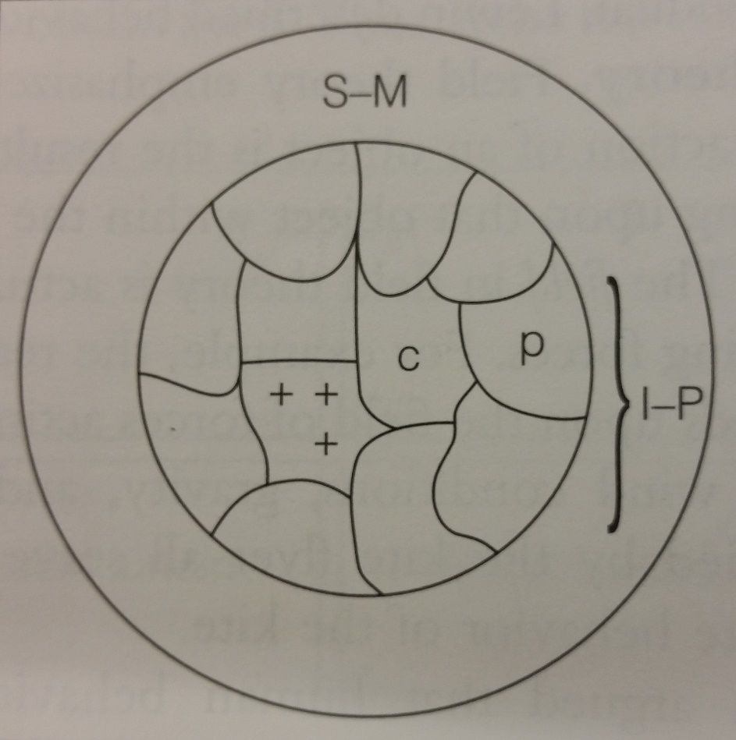
Lewin – Force Field Theory
The person
Sensory-Motor Region
  Perception
  Action
Tensions
  Physiological Needs
  Psychological Needs

Slide 82
How do I get a cup of coffee

Slide 83
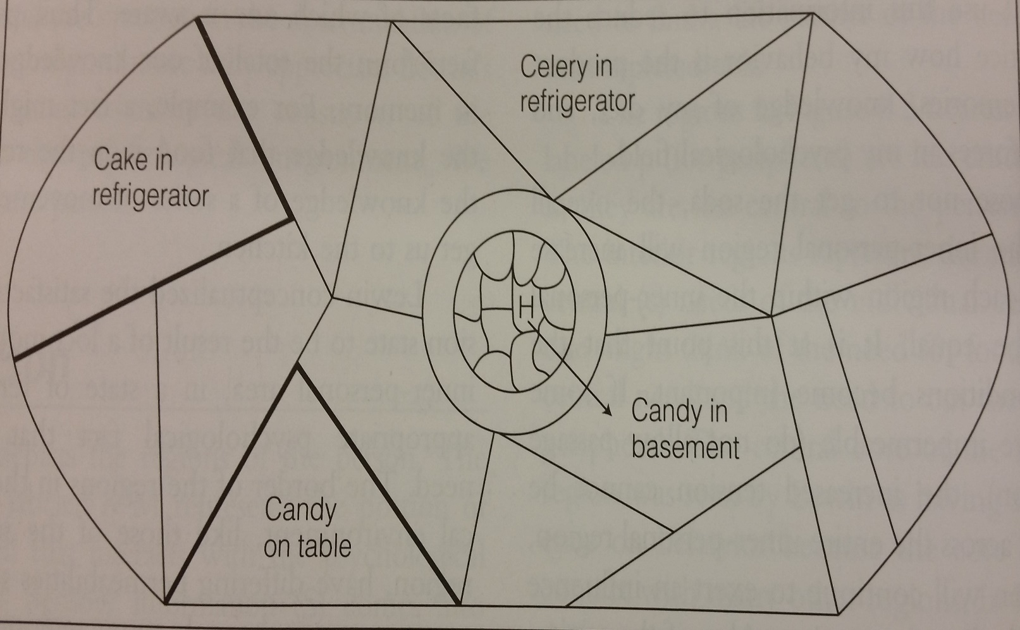
Lewin – Force Field Theory
The Psychological Environment
Regions
  Psychological Fact
  Fluidity
  Barriers
Valences
  Aproach/Avoidance +/-
  Intensity
Path
Locomotion

Slide 84
Life Space Interviewing Finding out the story
Remember, to the Youth truancy makes sense because of the story they tell themselves and believe
The task is to help the child to discover the story they tell themselves and to tell you about it.
Embedded in the story is the critical goal the youth seeking

Slide 85
Treatment – Life Space Interviewing
  Goal Centered recovery
    Critical that you understand the Youth’s goal
    In addition to the more obvious goals
    Each person needs to have a goal to link their motives to their behavior

Slide 86
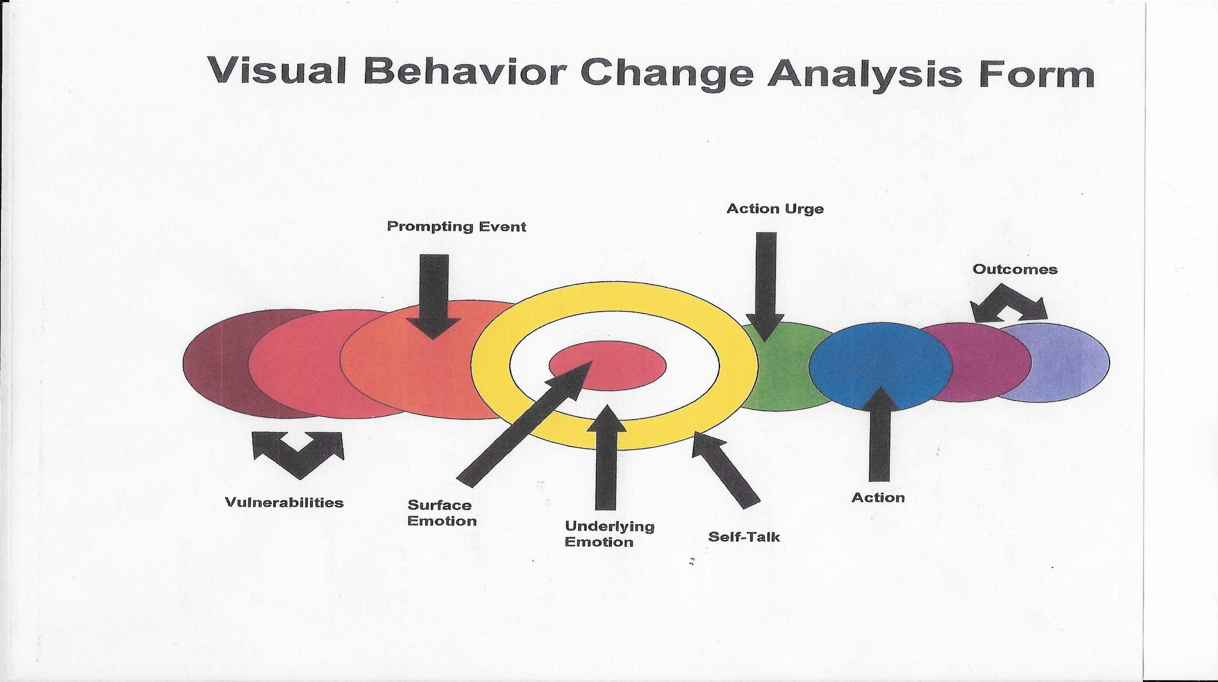
Chart Adapted from Lane Perderson & DBT

Slide 87
Possible Themes for stories that contribute to Truancy
Personal Factors: Look for the theme and the story
  Poor academic performance
  Special education needs
  Poor self esteem
  No real connection to school or school activities
  Unmet mental health needs
  Alcohol/drug use or abuse
  Lack of vision of education as a means to the future goals
  Peer pressure or inability to maintain friendships
  Feelings of rejection
  Embarrassment due to lack of “fashionable” clothing
  To meet with friends
  Abuse by significant others
  Child abuse and neglect
  Drug abuse and alcohol
  Childhood depression
  Asthma and other chronic illness
  Poor nutrition, dental, vision, hearing problems
  Neurological factors shame, embarrassment, giving up or compensating (good or bad)

Slide 88
The Book
Life Space Crisis Intervention

Slide 89
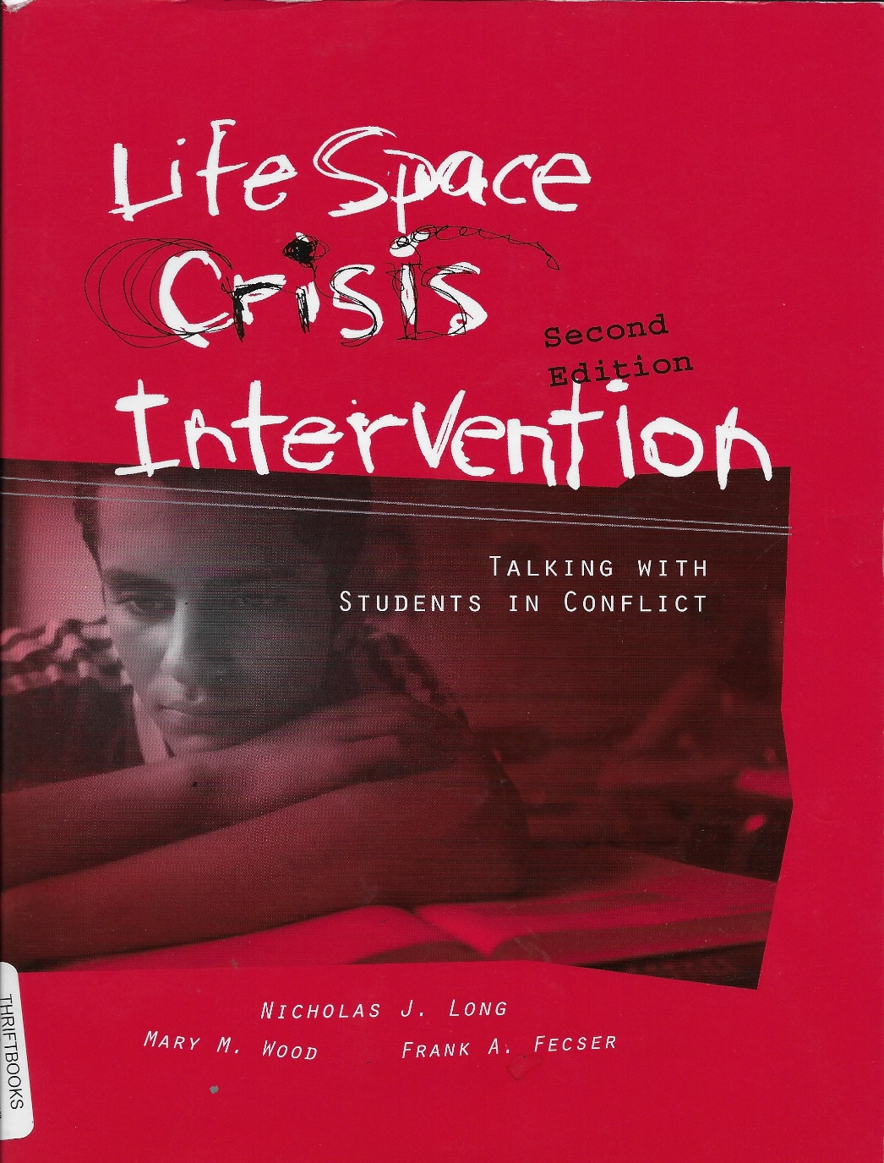
Long, Nicholas J., Wood, Mary M., Fecser, Frank A.

Slide 90
Summary: What you need to clarify
How each player defines truancy
Determine what is the best definition of truancy to assist the student’s real issue
Observe the power and connection among the players
What activities do you need, to change the player dynamics and help the youth
How much leverage do we need (role of players)
Pick carefully so as to not escalate or build resistance

Slide 91
Summary: What you need to clarify
What is the real purpose of the truancy – Kids story and goal
Is the truancy a proximal or distal problem or both
How engrained is the pattern
How serious and critical is the truancy
How much leverage do we need
Remember, just because he understand the story/goal you don’t need to agree.
Shared Squared!!!!!!!

Slide 92
Transparency
Shared Squared
“Information is power”
I don’t’ know
I know
I know that you know
I know that you know that I know
I know that you know that I know that you know

Slide 93
Slide Presentation @ www.bwcassociates.com
Under the “Resource” tab
Additional Great Resource
https://dc.gov/ Truancy Guide – 092415

